Slide 1
Ordering numbers in standard form
Standard form

Slide 2
How our teaching resources are designed for the classroom

Slide 3
I can compare and order numbers written in a mixture of standard, non−standard and not quite standard form.

Slide 4
Standard form is when a number is written in the form A × 10^{n}, (where 1 ≤ A < 10 and n is an integer).

Slide 5

Ordering numbers in standard form
Comparing numbers in standard form
Ordering numbers using standard form

Slide 6

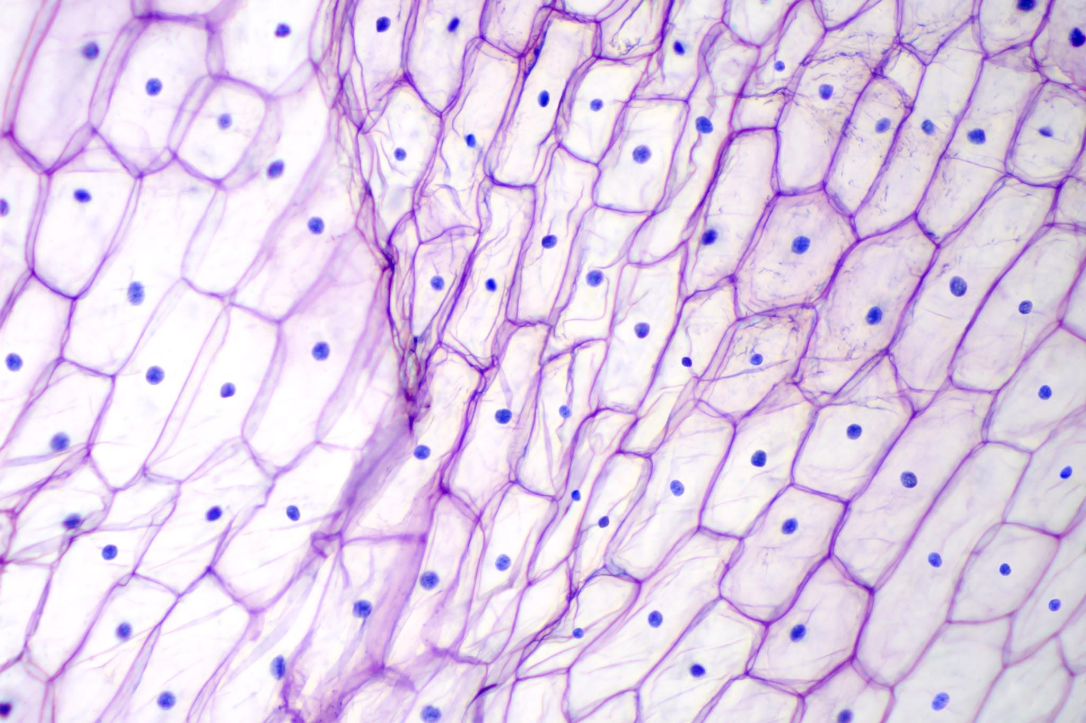
Comparing numbers in standard form
We know standard form is the convention to write very large or very small numbers.
We use standard form in a number of industries. For example,
Technology
Medicine
Having a convention to write very big or small numbers is important. As is knowing how to use them to recognise size and order.

Slide 7
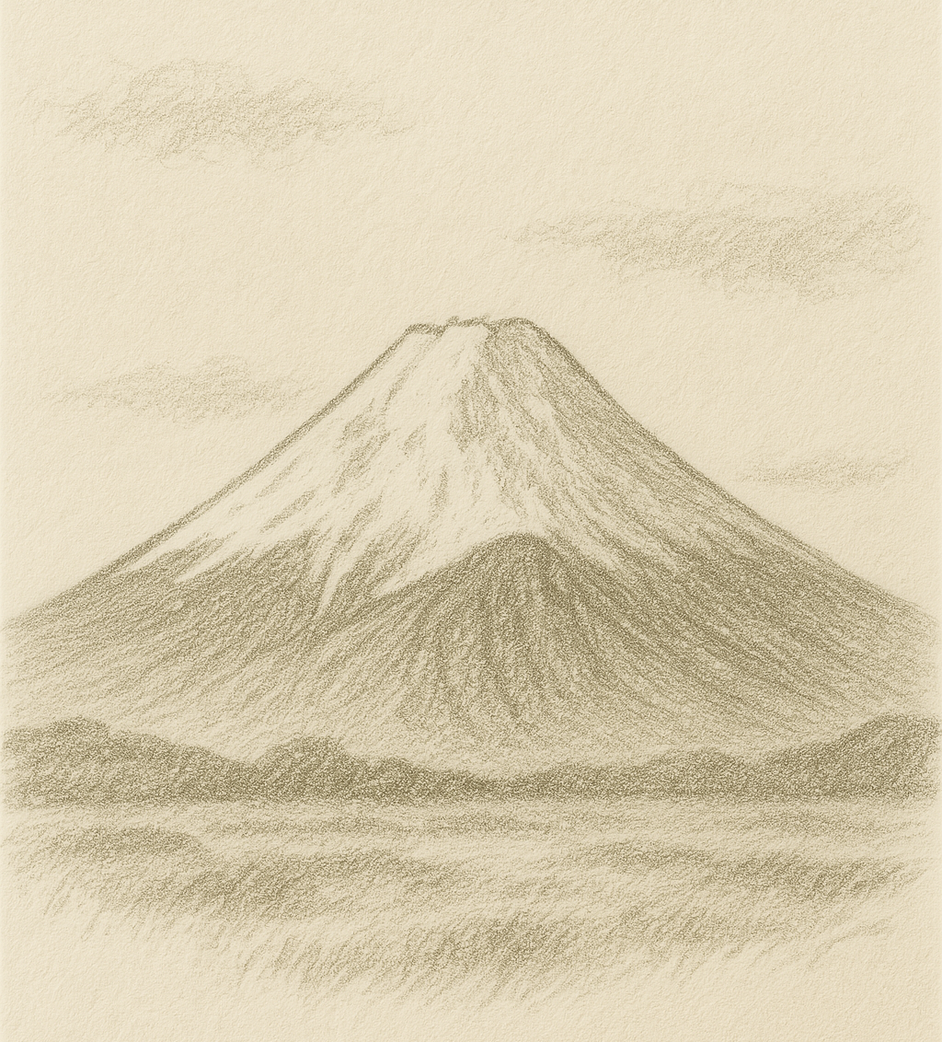
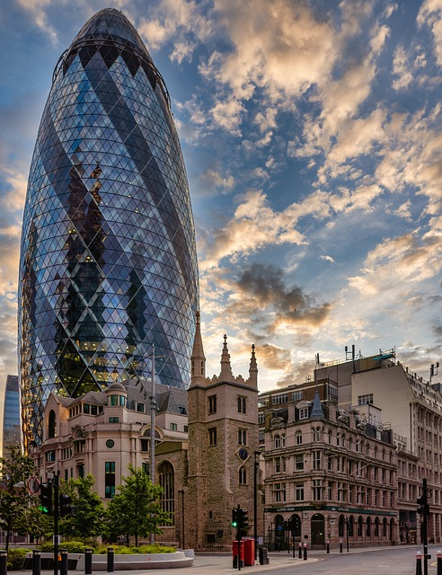
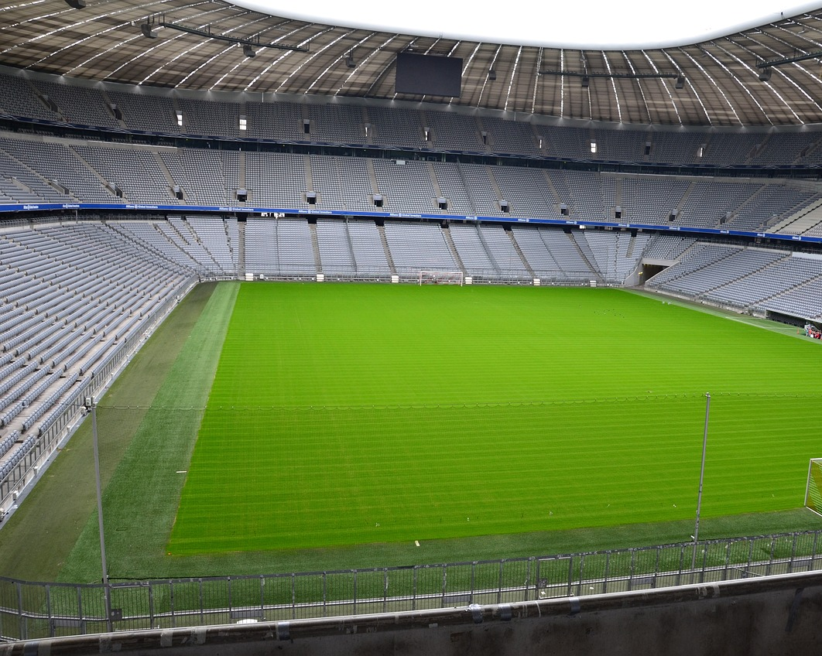


Comparing numbers in standard form
Put these different things in ascending order and match with the approximate standard form measurement.
1.1 × 10² m
1.1 × 10⁵ m
9.3 × 10 m
1.8 × 10² m
3.8 × 10³ m
The height of Mount Fuji
The height of The Gherkin
Length of a football pitch
The height of the Statue of Liberty
Latitude of the Earth

Slide 8
Comparing numbers in standard form
Putting the objects in ascending order first, we have:
The height of the Statue of Liberty
Length of a football pitch
The height of The Gherkin
The height of Mount Fuji
Latitude of the Earth

Slide 9
Comparing numbers in standard form
Matching with the approximate lengths in standard form:
9.3 × 10 m
1.1 × 10² m
1.8 × 10² m
3.8 × 10³ m
1.1 × 10⁵ m
The height of the Statue of Liberty
Length of a football pitch
The height of The Gherkin
The height of Mount Fuji
Latitude of the Earth

Slide 10
Comparing numbers in standard form
Removing the imagery, how do you identify these standard forms are in ascending order?
1
9.3 × 10 m
1.1 × 10² m
1.8 × 10² m
3.8 × 10³ m
1.1 × 10⁵ m
The exponents are in ascending order.

Slide 11
Comparing numbers in standard form
Removing the imagery, how do you identify these standard forms are in ascending order?
9.3 × 10 m
1.1 × 10² m
1.8 × 10² m
3.8 × 10³ m
1.1 × 10⁵ m
The exponents are in ascending order.
Where the exponents are the same, we order using the number.

Slide 12
Comparing numbers in standard form
Ordering using the exponents can also be seen using a place value chart. The bigger the exponent, the larger the number.
For example, 9 × 10¹⁰
> 9 × 10⁶
HB
TB
B
HM
TM
M
HTh
TTh
Th
H
T
O
t
10¹¹
10¹⁰
10⁹
10⁸
10⁷
10⁶
10⁵
10⁴
10³
10²
10¹
10⁰
10⁻¹
9 0 0 0 0 0 0 0 0 0 0
9 0 0 0 0 0 0

Slide 13
Comparing numbers in standard form
Alex says he has put these in ascending order, smallest to largest.
Find his error and explain why he has not correctly put them in ascending order.
1.56 × 10³
1.6 × 10³
2.1 × 10⁵
2.099 × 10⁵
3.41 × 10⁷

Slide 14
Comparing numbers in standard form
Alex says he has put these in ascending order, smallest to largest.
Find his error and explain why he has not correctly put them in ascending order.
1.56 × 10³
2.1 × 10⁵ > 2.099 × 10^{5.}
Converting 2.1 × 10⁵ to an ordinary number it is
210 000.
Whilst 2.099 × 10⁵ is
209 900.
Alternatively, given they both have the same base 10 exponent of 5, looking at 2.1 and 2.099, 2.1 is larger.
1.6 × 10³
2.1 × 10⁵
2.099 × 10⁵
3.41 × 10⁷

Slide 15
Comparing numbers in standard form
a) Put the following in ascending order, smallest to largest:
3.45 × 10³
2.48 × 10⁴
2.51 × 10⁴
9.8 × 10⁵
1.3 × 10⁹
1.3 × 10⁹
2.48 × 10⁴
2.51 × 10⁴
3.45 × 10³
9.8 × 10⁵
b) Put the following in ascending order, smallest to largest:
9.2 × 10
6.798 × 10²
6.8 × 10²
1.389 × 10⁴
2.1 × 10⁴
1.389 × 10⁴
2.1 × 10⁴
6.8 × 10²
9.2 × 10
6.798 × 10²

Slide 16




Comparing numbers in standard form
Now let’s look at really small objects. Put these objects in descending order, biggest to smallest and match with the approximate standard form.
2 × 10⁻⁶ m
8 × 10 ⁻⁵ m
1 × 10⁻¹⁰ m
2.5 × 10⁻² m
1.5 × 10⁻² m
Radius of an atom
Length of a strawberry
Width of a microchip
Thickness of a human hair
Width of a fingernail

Slide 17
Comparing numbers in standard form
Putting the objects first, largest to smallest, we have:
Length of a strawberry
Width of a fingernail
Thickness of a human hair
Width of a microchip
Radius of an atom

Slide 18
Comparing numbers in standard form
Matching with the approximate standard from lengths:
2.5 × 10⁻² m
1.5 × 10⁻² m
8 × 10 ⁻⁵ m
2 × 10⁻⁶ m
1 × 10⁻¹⁰ m
Length of a strawberry
Width of a fingernail
Thickness of a human hair
Width of a microchip
Radius of an atom

Slide 19
Comparing numbers in standard form
Removing the imagery, how do you identify these standard forms are in descending order?
2.5 × 10⁻² m
1.5 × 10⁻² m
8 × 10 ⁻⁵ m
2 × 10⁻⁶ m
1 × 10⁻¹⁰ m
The exponents are in descending order.

Slide 20
Comparing numbers in standard form
Removing the imagery, how do you identify these standard forms are in descending order?
2.5 × 10⁻² m
1.5 × 10⁻² m
8 × 10 ⁻⁵ m
2 × 10⁻⁶ m
1 × 10⁻¹⁰ m
The exponents are in descending order.
Where the exponents are the same, we order using the A number from A × 10^{n} .
Remember we are going in descending order here, biggest to smallest.

Slide 21
Comparing numbers in standard form
Ordering using the exponents can also be seen using a place value chart. The bigger the exponent, the larger the number.
For example, 2 × 10⁻⁵
> 2 × 10⁻⁹
O
t
h
th
tth
hth
m
tm
hm
b
tb
hb
10⁰
10⁻¹
10⁻²
10⁻³
10⁻⁴
10⁻⁵
10⁻⁶
10⁻⁷
10⁻⁸
10⁻⁹
10⁻¹⁰
10⁻¹¹
0 0 0 0 0 2
0 0 0 0 0 0 0 0 0 2

Slide 22
Comparing numbers in standard form
a) Put the following in ascending order, smallest to largest:
4.4 × 10⁻⁴
4.6 × 10⁻⁴
5.6 × 10⁻²
1.2 × 10⁻¹
1 × 10
5.6 × 10⁻²
1.2 × 10⁻¹
4.4 × 10⁻⁴
1 × 10
4.6 × 10⁻⁴
b) Put the following in ascending order, smallest to largest:
6.798 × 10⁻⁶
6.9 × 10⁻⁶
6.45 × 10
6.1 × 10⁶
6.798 × 10⁶
6.1 × 10⁶
6.45 × 10
6.798 × 10⁶
6.798 × 10⁻⁶
6.9 × 10⁻⁶

Slide 23
Comparing numbers in standard form
Aisha says she cannot put these in ascending order because they are not in standard form. Explain why she can put them in order and order these numbers in the form they are given.
Aisha can convert them all to standard form and then order, or convert them to an ordinary number and order. It is important to use this as working out so to order the form the question originally gave the value as.
0.00439
4.1 × 10⁻⁴
0.92
24 000
2.3 × 10⁴

Slide 24
Comparing numbers in standard form
Aisha says she cannot put these in ascending order because they are not in standard form. Explain why she can put them in order and order these numbers in the form they are given.
0.00439
4.1 × 10⁻⁴
0.92
24 000
2.3 × 10⁴
4.39 × 10⁻³
4.1 × 10⁻⁴
9.2 × 10⁻¹
2.4 × 10⁴
2.3 × 10⁴
With this working out, we can order the numbers given in their original form from the question.

Slide 25
Comparing numbers in standard form
Aisha says she cannot put these in ascending order because they are not in standard form. Explain why she can put them in order and order these numbers in the form they are given.
0.00439
4.1 × 10⁻⁴
0.92
24 000
2.3 × 10⁴
0.00439
4.1 × 10⁻⁴
0.92
24 000
2.3 × 10⁴
4.39 × 10⁻³
4.1 × 10⁻⁴
9.2 × 10⁻¹
2.4 × 10⁴
2.3 × 10⁴
4.1 × 10⁻⁴
0.00439
0.92
2.3 × 10⁴
24 000
Remember to order the original forms given, not the working out.

Slide 26
Comparing numbers in standard form
1) Put the following in ascending order, smallest to largest.
a)
b)
c)
d)
3 × 10¹²
1 × 10¹³
4 × 10¹¹
2 × 10¹⁰
9 × 10⁹
2.3 × 10⁴
2.3 × 10⁻¹
2.3 × 10⁻⁴
2.3 × 10⁻³
2.3 × 10
4.99 × 10⁶
4 × 10⁶
9.8 × 10⁻⁷
4.99 × 10⁻⁶
4.9 × 10⁻⁶
9.7 × 10⁻²
1.001 × 10⁹
9.89 × 10⁻²
1.5 × 10⁻⁴
1.01 × 10⁹

Slide 27
Comparing numbers in standard form
2) Put the following in ascending order in the format they are given.
a)
b)
1 × 10³
0.0089
0.1
8.2 × 10⁻⁴
90 000
21 000
0.000 087
0.0002
2.01 × 10⁴
0.000 078

Slide 28

Comparing numbers in standard form
3) Laura says
Explain why Laura has not correctly ordered the numbers.
I have put the following in ascending order by ordering the exponents first and where the exponents are the same, I have ordered the number.
Laura
0.6 × 10⁻¹
6 × 10²
6.2 × 10²
0.618 × 10³

Slide 29
Comparing numbers in standard form
1) Put the following in ascending order, smallest to largest.
a)
b)
c)
d)
3 × 10¹²
1 × 10¹³
4 × 10¹¹
2 × 10¹⁰
9 × 10⁹
9 × 10⁹
2 × 10¹⁰
4 × 10¹¹
3 × 10¹²
1 × 10¹³
2.3 × 10⁴
2.3 × 10⁻¹
2.3 × 10⁻⁴
2.3 × 10⁻³
2.3 × 10
2.3 × 10⁻⁴
2.3 × 10⁻³
2.3 × 10⁻¹
2.3 × 10
2.3 × 10⁴
4.99 × 10⁶
4 × 10⁶
9.8 × 10⁻⁷
4.99 × 10⁻⁶
4.9 × 10⁻⁶
9.8 × 10⁻⁷
4.9 × 10⁻⁶
4.99 × 10⁻⁶
4 × 10⁶
4.99 × 10⁶
1.5 × 10⁻⁴
9.7 × 10⁻²
9.89 × 10⁻²
1.001 × 10⁹
1.01 × 10⁹
9.7 × 10⁻²
1.001 × 10⁹
9.89 × 10⁻²
1.5 × 10⁻⁴
1.01 × 10⁹

Slide 30
Comparing numbers in standard form
2) Put the following in ascending order in the format they are given.
a)
1 × 10³
0.0089
0.1
8.2 × 10⁻⁴
90 000
1 × 10³
8.9 × 10⁻³
1 × 10⁻¹
8.2 × 10⁻⁴
9 × 10⁴
8.2 × 10⁻⁴
0.0089
0.1
1 × 10³
90 000

Slide 31
Comparing numbers in standard form
2) Put the following in ascending order in the format they are given.
b)
21 000
0.000 087
0.0002
2.01 × 10⁴
0.000 078
2.1 × 10⁴
8.7 × 10⁻⁵
2 × 10⁻⁴
2.01 × 10⁴
7.8 × 10⁻⁵
0.000 078
0.000 087
0.0002
2.01 × 10⁴
21 000

Slide 32
Comparing numbers in standard form
3) Laura says
Explain why Laura has not correctly ordered the numbers.
I have put the following in ascending order by ordering the exponents first and where the exponents are the same, I have ordered the number.
Laura
0.6 × 10⁻¹
6 × 10²
6.2 × 10²
0.618 × 10³
To order according to the exponents and then the A number, all the numbers must be correctly written in standard form. Some of these numbers are not in standard form.

Slide 33
Ordering numbers in standard form
Comparing numbers in standard form
Ordering numbers using standard form

Slide 34
Ordering numbers using standard form
Standard form allows a standard convention of writing very big or very small numbers. If it wasn’t for standard form, there would be too many different representations for the same number.
For example, all of these represent the same number 53

Slide 35
Ordering numbers using standard form
Working out the original number using skills on multiplication of fractions, the associative law and/or multiplication of decimals, allows us to write it correctly in standard form and order if needed.
For example, how would you work out the number:
There are lots of ways. You can do it in steps.
In standard form, 4.5 × 10⁴

Slide 36
Ordering numbers using standard form
Working out the original number using skills on multiplication of fractions, the associative law and/or multiplication of decimals, allows us to write it correctly in standard form and order if needed.
For example, how would you work out the number:
In standard form, 4.5 × 10⁴
In standard form, 4.69 × 10⁻¹

Slide 37
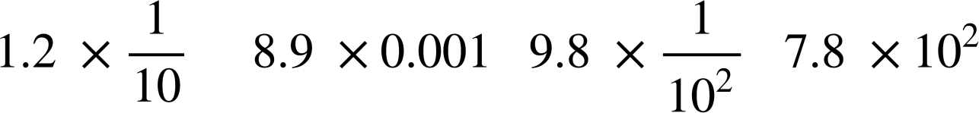
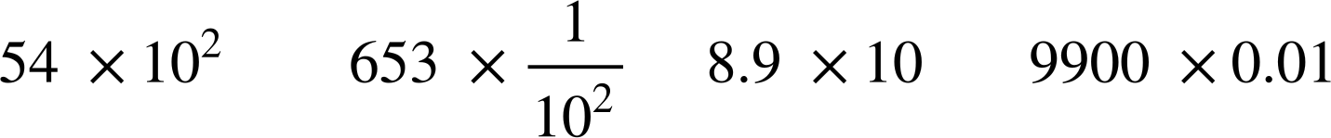

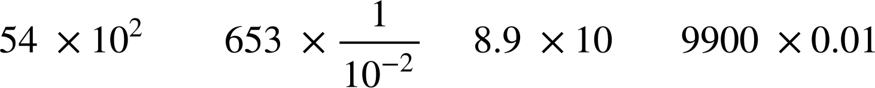
Ordering numbers using standard form
Using correct standard form, put these numbers in ascending order (smallest to largest)
Using correct standard form, put these numbers in ascending order (smallest to largest)
= 8.9 × 0.1 × 0.1 × 0.1
= 0.0089
= 8.9 × 10⁻³
= 54 × 10 × 10
= 5400
= 5.4 × 10³
= 0.12
= 1.2 × 10⁻¹
= 653 × ×
= 6.53
= 6.53 × 10⁰
= 7.8 × 10²
= 8.9 × 10
= 9900 × 0.1 × 0.1
= 99
= 9.9 × 10
= 9.8 × ×
= 0.098
= 9.8 × 10⁻²

Slide 38
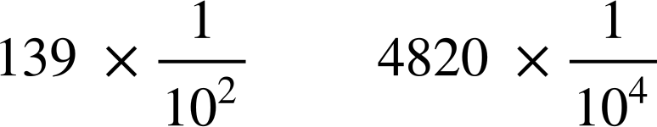
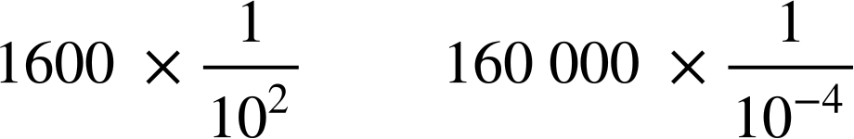
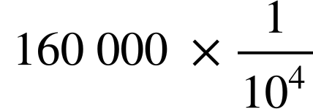
Ordering numbers using standard form
1) Using inequalities, <, > or =, compare the sizes of each number, making sure to show your working out.
a)
b)
c)
d)

Slide 39

Ordering numbers using standard form
2) By working out the number, write in standard form and order the original form given in the question.
a)
b)
c)

Slide 40
Ordering numbers using standard form
1) Using inequalities, <, > or =, compare the sizes of each number, making sure to show your working out.
a)
b)
c)
d)
>
3.8 × 10⁻¹ > 4.8 × 10⁻²
<
7.8 × 10 < 9.9 × 10³
>
1.39 × 10⁰ > 4.82 × 10⁻¹
=
1.6 × 10¹ = 1.6 × 10¹

Slide 41
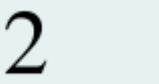
Ordering numbers using standard form
2) By working out the number, write in standard form and order the original form given in the question.
a)
3.8 × 10⁻³
7.9 × 10⁻¹
7.8 × 10⁻²
8 × 10⁰

Slide 42
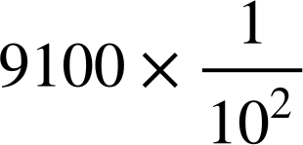
Ordering numbers using standard form
2) By working out the number, write in standard form and order the original form given in the question.
b)
9.2 × 10⁻²
9.21 × 10
9.8 × 10⁻¹
9.1 × 10

Slide 43
Ordering numbers using standard form
2) By working out the number, write in standard form and order the original form given in the question.
c)
4.8 × 10
4.8 × 10⁻²
4.81 × 10⁻²
4.82 × 10⁻¹

Slide 44
Ordering numbers in standard form
We know standard form is the convention to write very large or very small numbers.
We use standard form in a number of industries.
Once numbers are written in standard form, we can order using the exponents. The bigger the exponent, the larger the number.
For example, 9 × 10¹⁰ > 9 × 10⁶
For example, 2 × 10⁻⁵ > 2 × 10⁻⁹
Converting all calculations to standard form, or sometimes to an ordinary number, allows ordering to be more efficient.

Slide 45

© Oak National Academy 2024.
Produced in partnership with Mathematics in Education and Industry.
Licensed on the Open Government Licence v3.0, except where otherwise stated. See Oak terms and conditions.

